Slide 1




Slide 2

Test Time On GCD of an Array
URL : https://forms.gle/gd2VujE5hj9mtFLq5

Slide 3

BLOCK SWAP ALGORITHM

Slide 4

TOPICS
Introduction to Block Swap Algorithm
Real-Life Analogy
Why is Block Swap Efficient?
Types of Approaches for Array Rotation
Efficiency Comparison of Approaches - Array Rotation
Block Swap Algorithm - Algorithm and Code
Reversal Algorithm - Algorithm and Code
Real Time Applications - Block Swap Algorithm
Company Placement Questions
Financial Rotation Analytics

Slide 5
Introduction to Block Swap Algorithm
The Block Swap Algorithm is an efficient algorithm used for array rotation.
It rotates the elements of an array by swapping blocks of elements instead of moving elements one by one.
This approach reduces unnecessary movements and performs rotation efficiently without using extra memory.
Example
Original Array: [1, 2, 3, 4, 5, 6, 7]
Left Rotate by 3 Positions:
Result: [4, 5, 6, 7, 1, 2, 3]

Slide 6
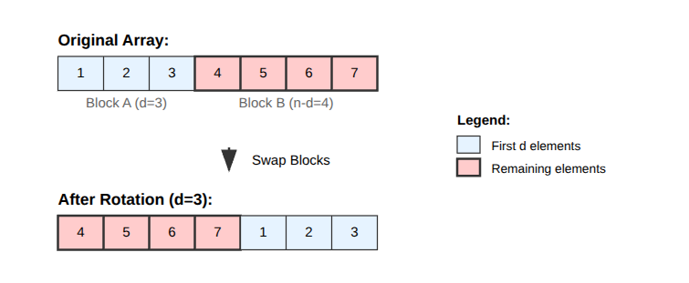
Example Explanation

Slide 7

Real-Life Analogy – Books on a Shelf
Imagine you have a row of books arranged on a shelf, and you want to rotate the arrangement.
Example
You have 10 books:
[Book1, Book2, Book3, Book4, Book5, Book6, Book7, Book8, Book9, Book10, Book11,Book12, Book13]
You want to perform a left rotation by 3 positions.
Desired Output
[Book4, Book5, Book6, Book7, Book8, Book9, Book10, Book11,Book12, Book13, Book1, Book2, Book3]

Slide 8
Core Idea of Block Swap Algorithm
Instead of shifting books one by one:
The algorithm swaps entire groups of books.
Equal-sized parts are exchanged repeatedly.
The process continues until the rotation is completed.
This makes the algorithm faster and more efficient.

Slide 9
Real Life Analogy - People in a Line Analogy
Imagine two groups of people standing in a line:
Group A → First few people
Group B → Remaining people
Case 1: Both Groups Are Equal
If both groups contain the same number of people:
Simply swap their positions.
Rotation is completed immediately.
Case 2: Groups Are Unequal
If one group is smaller:
Swap equal-sized portions from both groups.
Repeat the process with the remaining larger section.
This continues until all groups are correctly positioned.

Slide 10
Why is Block Swap Efficient?
Advantages
Elements are moved as groups instead of individually.
Each element is moved only once.
No additional memory is required.
Faster than simple shifting methods.
Performs rotation in-place.

Slide 11
Types of Approaches for Array Rotation
1. Naive Approach
Shift elements one by one
Repeat rotation multiple times
Simple but slower
2. Temporary Array Approach
Store some elements in extra array
Shift remaining elements
Copy stored elements back
3. Juggling Algorithm
Divide array into cycles
Rotate elements cyclically
Uses GCD concept
4. Reversal Algorithm
Reverse parts of array
Reverse complete array
Rotation achieved through reversals
5. Block Swap Algorithm
Divide array into blocks
Swap equal-sized blocks
Repeat recursively until rotation completes

Slide 12
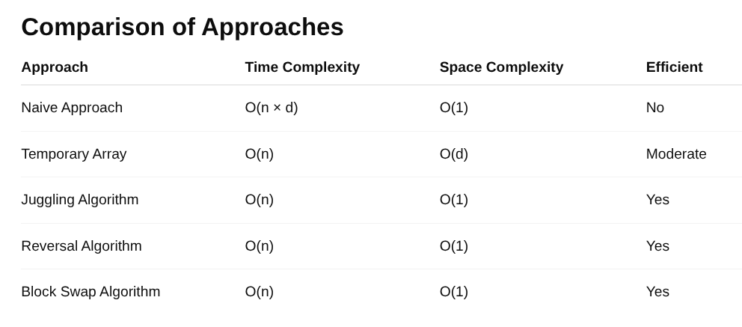
Efficiency Comparison of Approaches - Array Rotation

Slide 13
Block Swap Algorithm - Algorithmic Steps
Algorithmic Steps
Read the size of the array.
Read all array elements.
Read the number of positions d to rotate.
Divide the array into two blocks:
Block A → First d elements
Block B → Remaining elements
Compare sizes of both blocks.

Slide 14
Block Swap Algorithm - Algorithmic Steps
Algorithmic Steps
6. Swap equal-sized portions of the blocks.
7. Recursively repeat the process for the remaining part.
8. Continue until both blocks become equal.
9. Perform the final swap.
10. Print the rotated array.

Slide 15
Sample Input and Output
Sample Input 1
Enter array size: 7
Enter array elements:
1 2 3 4 5 6 7
Enter number of positions to rotate: 2
Sample Output 1
Rotated Array:
3 4 5 6 7 1 2
Explanation
The array is rotated left by 2 positions.
Original Array: [1, 2, 3, 4, 5, 6, 7]
First 2 elements are moved to the end:
[3, 4, 5, 6, 7, 1, 2]
So, the rotated array becomes:
3 4 5 6 7 1 2

Slide 16
Sample Input and Output
Sample Input
Enter array size: 5
Enter array elements:
1 2 3 4 5
Enter number of positions to rotate: 7
Sample Output
Rotated Array:
3 4 5 1 2
Explanation
Array size = 5
Rotation = 7
Since 7 % 5 = 2
The array is effectively rotated left by 2 positions.

Slide 17
Java Code - Block Swap Algorithm
import java.util.Scanner;
public class Main {
static void swap(int[] arr, int fi, int si, int d) {
for (int i = 0; i < d; i++) {
int temp = arr[fi + i];
arr[fi + i] = arr[si + i];
arr[si + i] = temp;
} }
static void leftRotateRec(int[] arr, int i, int d, int n) {
if (d == 0 || d == n)
return;
if (d == n - d) {
swap(arr, i, n - d + i, d);
return; }
if (d < n - d) {
swap(arr, i, n - d + i, d);
leftRotateRec(arr, i, d, n - d);
}
else {
swap(arr, i, d + i, n - d);
leftRotateRec(arr, n - d + i, 2 * d - n, d);
} }
static void leftRotate(int[] arr, int d, int n) {
leftRotateRec(arr, 0, d, n); }
static void printArray(int[] arr) {
for (int num : arr)
System.out.print(num + " "); }

Slide 18
Java Code - Block Swap Algorithm
public static void main(String[] args) {
Scanner sc = new Scanner(System.in);
System.out.print("Enter array size: ");
int n = sc.nextInt();
int[] arr = new int[n];
System.out.println("Enter array elements:");
for (int i = 0; i < n; i++) {
arr[i] = sc.nextInt();
}
System.out.print("Enter positions to rotate: ");
int d = sc.nextInt();
d = d % n;
leftRotate(arr, d, n);
System.out.println("Rotated Array:");
printArray(arr);
sc.close();
}
}

Slide 19
Time and space Complexity - Block swap Algorithm
Time Complexity:
If the array has n elements, the algorithm processes all elements through block swaps.
No nested full traversals are performed.
Hence execution time increases linearly with array size.
Time Complexity : O(n)
Space Complexity:
Since the rotation happens within the same array,
memory usage remains constant regardless of input size.
Space Complexity : O(1)

Slide 20
Reversal Algorithm - Algorithmic Steps
Algorithmic Steps
Read the size of the array.
Read the array elements.
Read the number of positions d to rotate.
Reverse the first d elements.
Reverse the remaining n-d elements.
Reverse the entire array.
Print the rotated array.

Slide 21
Sample Input and Output
Sample Input
Enter array size: 7
Enter array elements:
1 2 3 4 5 6 7
Enter number of positions to rotate: 2
Sample Output
Rotated Array:
3 4 5 6 7 1 2
Short Explanation
First reverse first 2 elements → 2 1 3 4 5 6 7
Reverse remaining elements → 2 1 7 6 5 4 3
Reverse entire array → 3 4 5 6 7 1 2

Slide 22
Java Code - Reversal Algorithm
import java.util.Scanner;
public class Main {
static void reverse(int arr[], int start, int end) {
while (start < end) {
int temp = arr[start];
arr[start] = arr[end];
arr[end] = temp;
start++;
end--;
}
}
static void rotateLeft(int arr[], int d, int n) {
d = d % n;
reverse(arr, 0, d - 1);
reverse(arr, d, n - 1);
reverse(arr, 0, n - 1);
}
public static void main(String[] args) {
Scanner sc = new Scanner(System.in);
System.out.print("Enter array size: ");
int n = sc.nextInt();
int arr[] = new int[n];

Slide 23
Java Code - Reversal Algorithm
System.out.println("Enter array elements:");
for (int i = 0; i < n; i++) {
arr[i] = sc.nextInt();
}
System.out.print("Enter number of positions to rotate: ");
int d = sc.nextInt();
rotateLeft(arr, d, n);
System.out.println("Rotated Array:");
for (int i = 0; i < n; i++) {
System.out.print(arr[i] + " ");
}
sc.close();
}
}

Slide 24
Time and space Complexity - Reversal Algorithm
Time Complexity
reverse(arr, 0, d - 1) processes first d elements
reverse(arr, d, n - 1) processes remaining n-d elements
reverse(arr, 0, n - 1) processes all n elements
Total operations together are proportional to n
Time Complexity : O(n)
Space Complexity
No new array is created in the code
Swapping is done inside the same array
Only one temporary variable temp is used during reversal
Space Complexity : O(1)

Slide 25
Real Time Applications - Block Swap Algorithm
Memory Management – Efficient memory block movement
Circular Queue Rotation – Rotating scheduled tasks
Load Balancing Systems – Distributing server workloads
Data Streaming Applications – Managing streaming buffers
Image Processing – Rotating pixel blocks
Database Record Rotation – Cyclic record arrangement
Gaming Applications – Managing player turns
Network Packet Scheduling – Fair packet distribution
Music Playlist Rotation – Cyclic song arrangement
Financial Trading Systems – Rotating transaction logs

Slide 26
Company Placement Question - Block Swap Algorithm
Problem Statement
A company stores employee shift IDs in an array. To manage rotational shifts, the first d employee IDs must be moved to the end of the array while maintaining their original order.
You must perform the rotation using the Block Swap Algorithm without using any extra array. Write a Java program to rotate the array to the left by d positions.
Input Format
First line contains integer n → size of array
Second line contains n space-separated integers
Third line contains integer d → number of positions to rotate
Output Format
Print the rotated array
Asked in Adobe (2025)

Slide 27

Company Placement Question - Block Swap Algorithm
Sample Input
Enter array size: 7
Enter array elements:
1 2 3 4 5 6 7
Enter number of positions to rotate: 2
Sample Output
Rotated Array:
3 4 5 6 7 1 2

Slide 28
Java Code for Block Swap Algorithm
import java.util.Scanner;
public class Main {
static void swap(int[] arr, int fi, int si, int d) {
for (int i = 0; i < d; i++) {
int temp = arr[fi + i];
arr[fi + i] = arr[si + i];
arr[si + i] = temp;
}
}
static void leftRotate(int[] arr, int d, int n) {
if (d == 0 || d == n)
return;
int i = d;
int j = n - d;
while (i != j) {
if (i < j) {
swap(arr, d - i, d + j - i, i);
j = j - i;
}
else {
swap(arr, d - i, d, j);
i = i - j;
}
}
swap(arr, d - i, d, i);
}

Slide 29
Java Code for Block Swap Algorithm
public static void main(String[] args) {
Scanner sc = new Scanner(System.in);
System.out.print("Enter array size: ");
int n = sc.nextInt();
int[] arr = new int[n];
System.out.println("Enter array elements:");
for (int i = 0; i < n; i++) {
arr[i] = sc.nextInt();
}
System.out.print("Enter number of positions to rotate: ");
int d = sc.nextInt();
d = d % n;
leftRotate(arr, d, n);
System.out.println("Rotated Array:");
for (int num : arr) {
System.out.print(num + " ");
}
sc.close();
}
}
Time Complexity : O(N) Space Complexity : O(1)

Slide 30
Financial Rotation Analytics
Problem Statement
A trading system rotates stock transaction values using the Block Swap Algorithm. After rotation
Find the maximum profit possible (arr[j] - arr[i] where j > i)
Count local peaks (arr[i] > arr[i-1] && arr[i] > arr[i+1])
Print whether the array becomes fully sorted after rotation.
Sample Input Format
First line represents the size of the array N
Second line represents N space-separated integer elements
Third line represents the number of positions to rotate D
Sample Output Format
Print the rotated array
Asked in Goldman Sachs (2025)

Slide 31
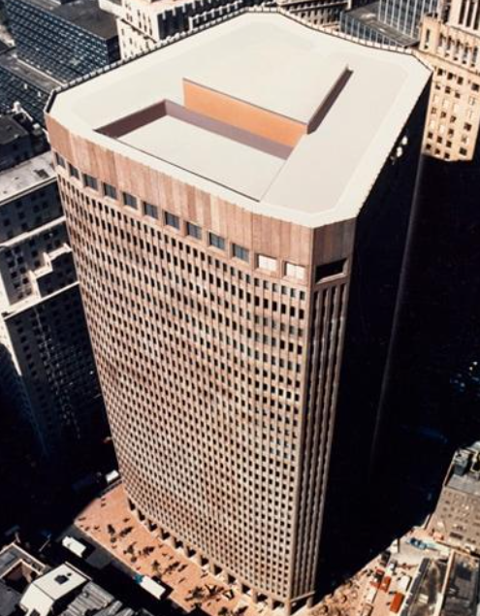
Financial Rotation Analytics
Sample Output Format
Print the maximum profit
Print the number of local peaks
Print whether the array is sorted or not
Sample Input
8
40 10 60 20 80 30 100 50
3
Sample Output
Rotated Array: 20 80 30 100 50 40 10 60
Maximum Profit: 80
Local Peaks: 3
Array is not sorted

Slide 32
Java Code - Financial Rotation Analytics
import java.util.Scanner;
public class Main {
static void swap(int[] arr, int fi, int si, int d) {
for (int i = 0; i < d; i++) {
int temp = arr[fi + i];
arr[fi + i] = arr[si + i];
arr[si + i] = temp;
}
}
static void leftRotate(int[] arr, int d, int n) {
if (d == 0 || d == n)
return;
int i = d;
int j = n - d;
while (i != j) {
if (i < j) {
swap(arr, d - i, d + j - i, i);
j = j - i;
} else {
swap(arr, d - i, d, j);
i = i - j;
} }
swap(arr, d - i, d, i);
}
static boolean isSorted(int[] arr, int n) {
for (int i = 0; i < n - 1; i++) {
if (arr[i] > arr[i + 1])
return false;
}
return true;

Slide 33
Java Code - Financial Rotation Analytics
public static void main(String[] args) {
Scanner sc = new Scanner(System.in);
int n = sc.nextInt();
int[] arr = new int[n];
for (int i = 0; i < n; i++) {
arr[i] = sc.nextInt(); }
int d = sc.nextInt();
d = d % n;
leftRotate(arr, d, n);
System.out.println("Rotated Array:");
for (int x : arr) {
System.out.print(x + " "); }
System.out.println();
int minValue = arr[0];
int maxProfit = 0;
for (int i = 1; i < n; i++) {
if (arr[i] - minValue > maxProfit) {
maxProfit = arr[i] - minValue;}
if (arr[i] < minValue) {
minValue = arr[i];
}
}
int peaks = 0;
for (int i = 1; i < n - 1; i++) {
if (arr[i] > arr[i - 1] && arr[i] > arr[i + 1]) {
peaks++;
}
}

Slide 34
Java Code - Financial Rotation Analytics
System.out.println("Maximum Profit: " + maxProfit);
System.out.println("Local Peaks: " + peaks);
if (isSorted(arr, n))
System.out.println("Array is sorted");
else
System.out.println("Array is not sorted");
sc.close();
}
}
Maximum Profit → O(n)
Local Peaks → O(n)
Sorted Check → O(n)
No extra array or additional data structure is used.
Rotation is done in-place using swaps.
Only a few variables are used (i, j, maxProfit, peaks, etc.)
Time Complexity : O(n)
Space Complexity: O(1)

Slide 35
Interview questions
Question
In the Block Swap Algorithm, when both blocks are of equal size, what operation is performed?
Options
A) Reverse the entire array B) Swap both blocks directly C) Delete one block D) Sort the array
Asked in Microsoft (2026) - MCQ
Answer : B) Swap both blocks directly

Slide 36
Interview questions
Asked in Infosys (2025) - MCQ
Question
In the Block Swap Algorithm, if Block A is smaller than Block B, what happens?
Options
A) Entire array is reversed B) Equal-sized parts are swapped and recursion continues C) Array gets sorted D) Rotation stops immediately
Answer : B) Equal-sized parts are swapped and recursion continues

Slide 37
Interview questions
Describe the Block Swap algorithm and how it works
The Block Swap algorithm is used to rotate an array by a given number of positions. It involves swapping blocks of elements within the array to achieve rotation. The algorithm divides the array into two blocks, A and B, where A has the first d elements and B has the remaining elements. It then performs a series of swaps to move the elements from A to B and vice versa, until the desired rotation is achieved

Slide 38
Interview questions
What is the time complexity of the Block Swap algorithm?
The time complexity of the Block Swap algorithm is O(n), where n is the number of elements in the array.

Slide 39
Interview questions
What are the applications of the Block Swap algorithm?
Rotating elements in an array or a string.
Implementing circular queues or buffers.
Performing cyclic shifts in cryptographic algorithms.
Reordering elements in certain data structures or algorithms.

Slide 40


Help Desk
Any concerns related to attendance/marks/ faculty ; you can reach out to ETHNUS helpdesk through the displayed QR code
https://codemithra.com/vit-helpdesk/

Slide 41

https://learn.codemithra.com

Slide 42
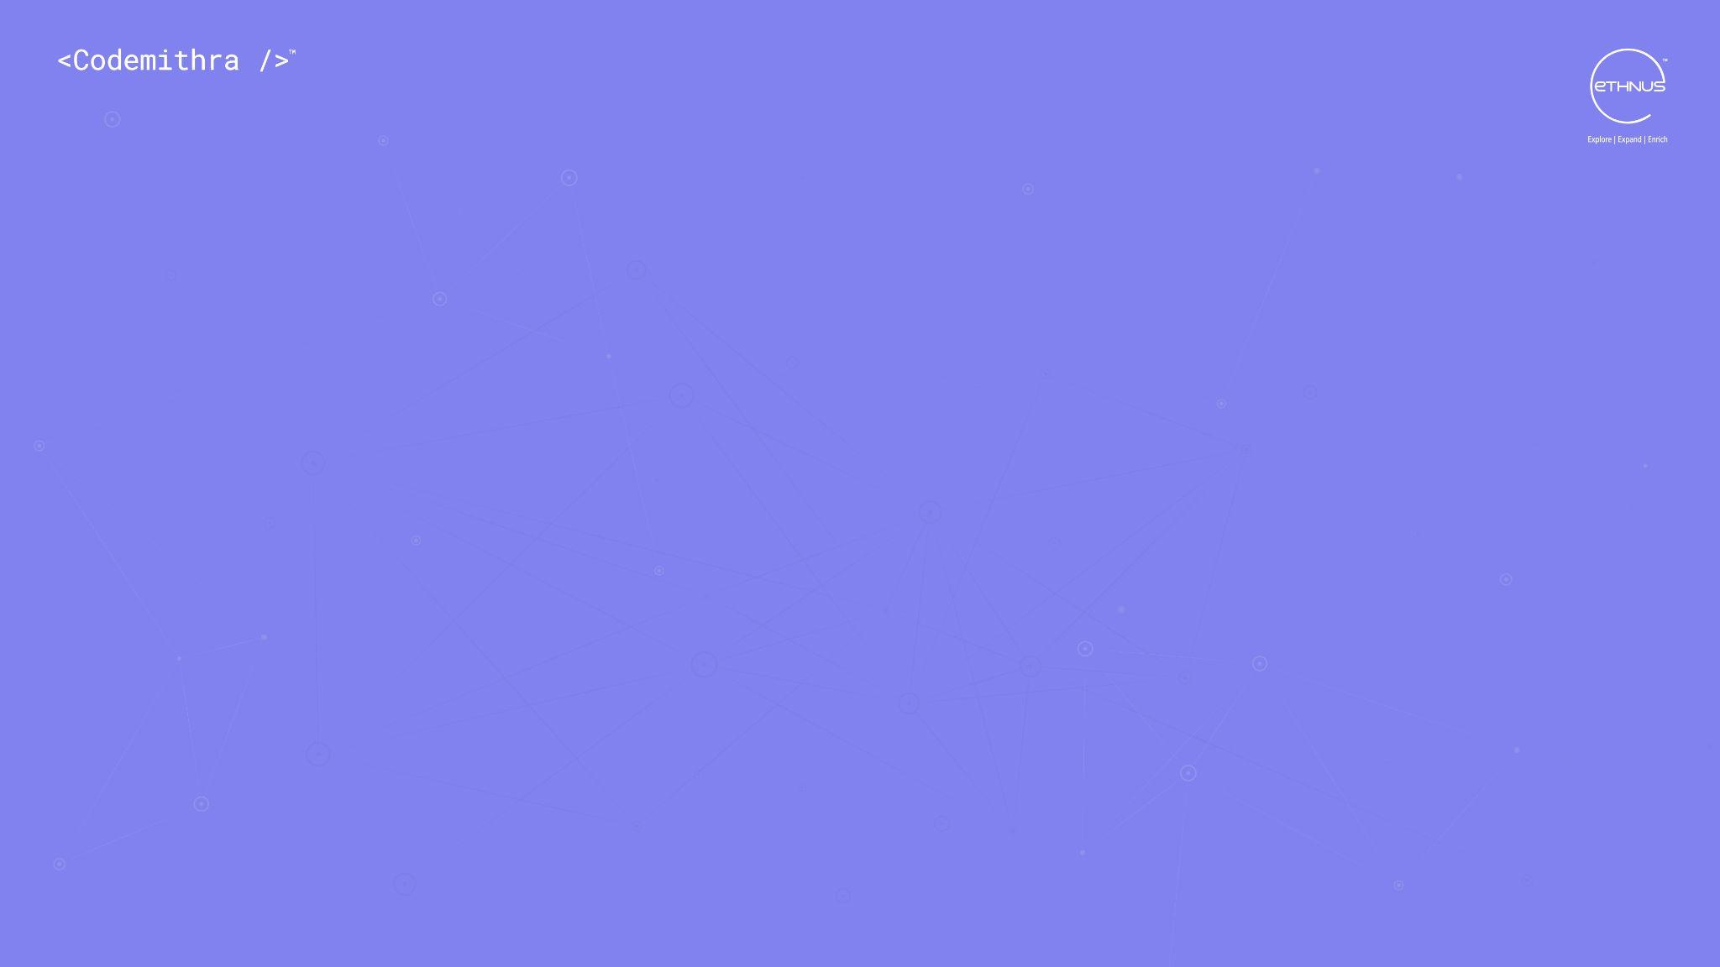



THANK YOU
+91 78150 95095
codemithra@ethnus.com
www.codemithra.com

